Slide 1

Today’s Agenda
JK and T flip flops
Analysis of sequential circuits

Slide 2
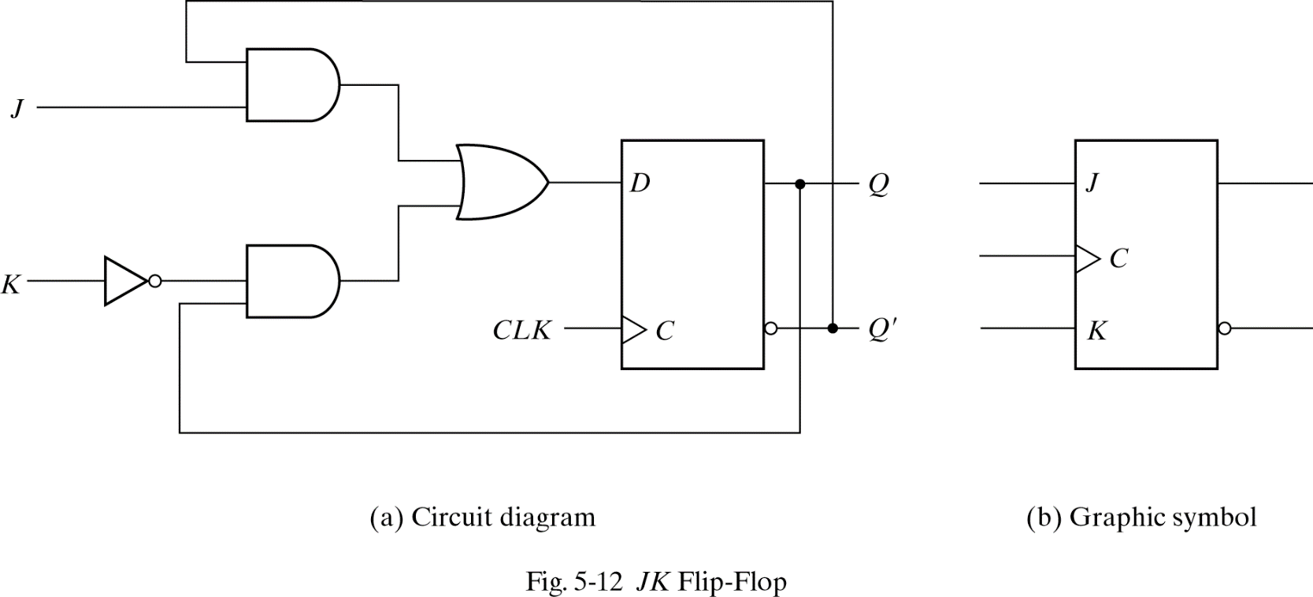
Positive Edge-Triggered J-K Flip-Flop
D=JQ’(t) + K’Q(t) = JQ’ + K’Q
Created from D flop
J sets
K resets
J=K=1 -> invert output
J
K
CLK
Q(t+1)
Q’(t+1)
0 0
↑
Q(t) Q’(t)
0 1
↑
0 1
1 0
↑
1 0
1 1
↑
Toggle.

Slide 3
Characteristic Table and Equation of JK Flip Flop
Characteristic Equation:
D=JQ’(t) + K’Q(t) = JQ’ + K’Q
Q(t+1) = D
Q(t+1)= JQ’ + K’Q
Characteristic Table
J
K
CLK
Q(t+1)
Q’(t+1)
0 0
Q(t) Q’(t)
↑
0 1
↑
0 1
1 0
↑
1 0
1 1
↑
Toggle.

Slide 4
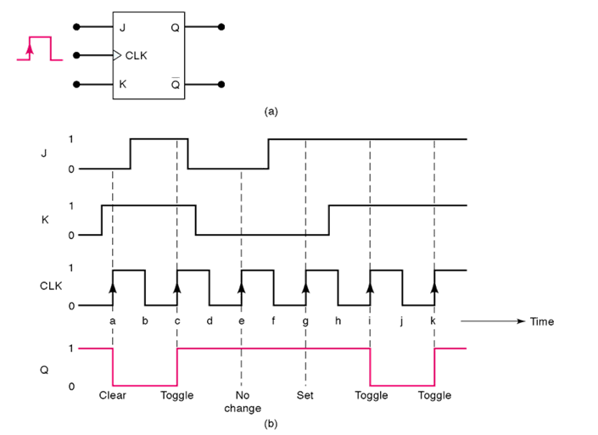
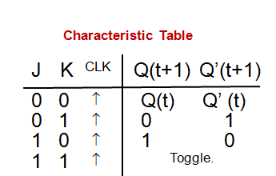
Timing Diagram of J-K Flip Flop
Two data inputs, J and K
J -> set, K -> reset, if J=K=1 then toggle output

Slide 5
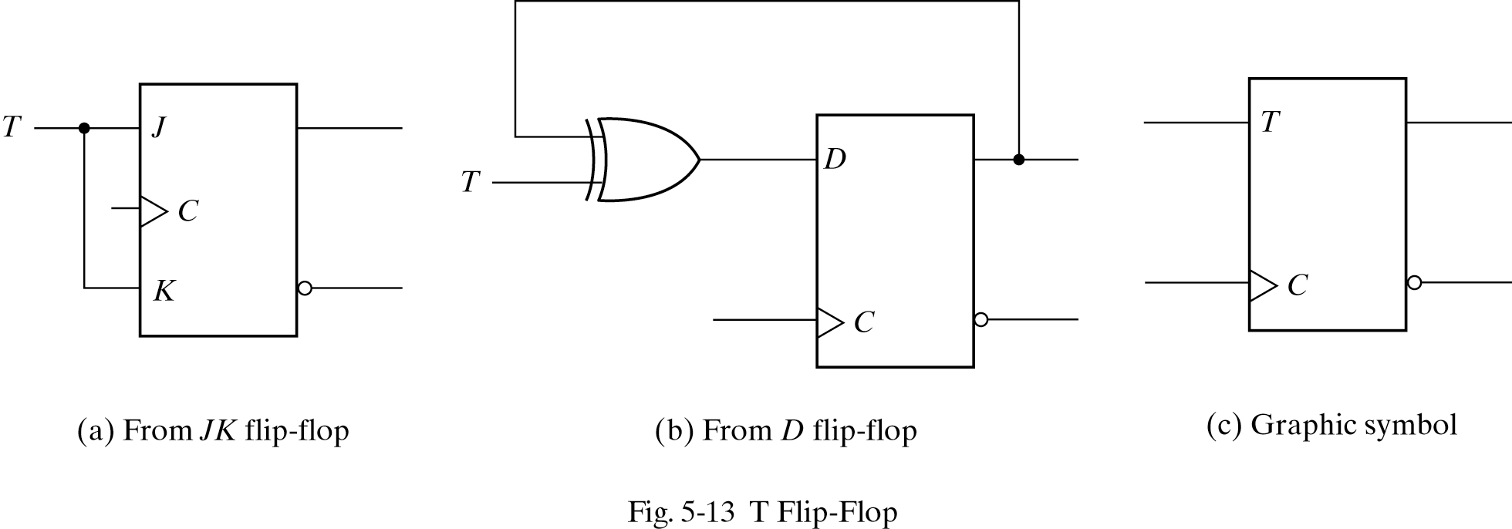
Positive Edge-Triggered T Flip-Flop
D=TQ’(t) + T’Q(t) = TQ’ + T’Q
Created from D flop
T=0 -> keep current
K resets
T=1 -> invert current
T
Q(t+1)
C
Q’(t+1)
0
Q(t) Q’(t)
↑
1
TOGGLE
↑

Slide 6
Characteristic Table and Equation of T Flip Flop
Characteristic Equation:
D=TQ’(t) + T’Q(t) = TQ’ + T’Q
Q(t+1) = D
Q(t+1) = TQ’ + T’Q
Characteristic Table
T
Q(t+1)
C
Q’(t+1)
↑
0
Q(t) Q’(t)
1
TOGGLE
↑

Slide 7
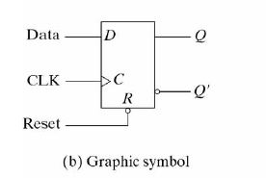
Asynchronous Inputs
Asynchronous inputs are used to force the flip flop to a particular state independently of the clock.
When the power is turned on in digital system, the state of flip flops is unknown. The asynchronous inputs are very useful to bring all flip flops in a known state before starting the clocked operation.
The input that sets the flip flop to 1 is called preset. And the input that sets the flip flop to ‘0’ is called reset.
R D
Q(t+1)
C
Q’(t+1)
0 X X 0 1
1 0 0 1
1 1 1 0

Slide 8
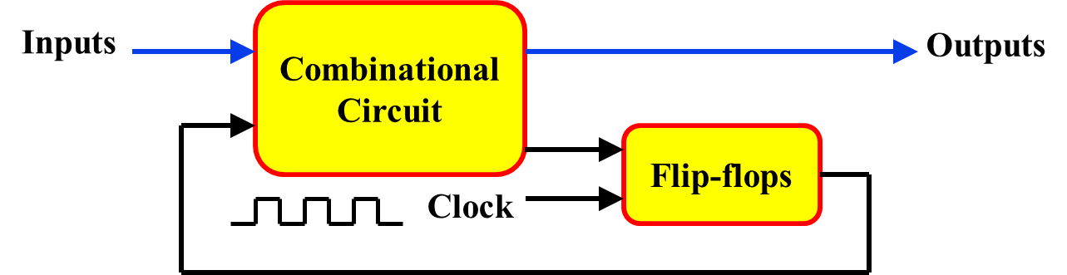
Analysis of Synchronous Sequential Circuits
Analysis:
  Describes what a given circuit will do under certain operating conditions
Behavior of the cct. is determined from:
  Inputs,
  Outputs
  State of its F/Fs.
O/p and next states are determined from:
  Inputs
  Present state of its F/Fs.

Slide 9
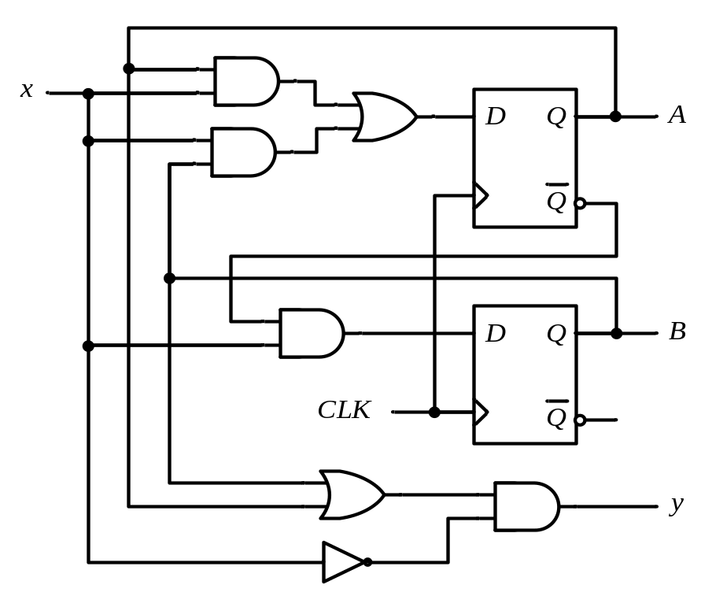
Analysis of Clocked Sequential Circuits
Analysis consists of obtaining:
  Boolean expressions (State Equations)
  Table (State Table)
  Diagram (State Diagram)
  for time sequence of inputs, outputs, and internal states
The State
  State = Values of all F/Fs
Example
A B = 0 0

Slide 10
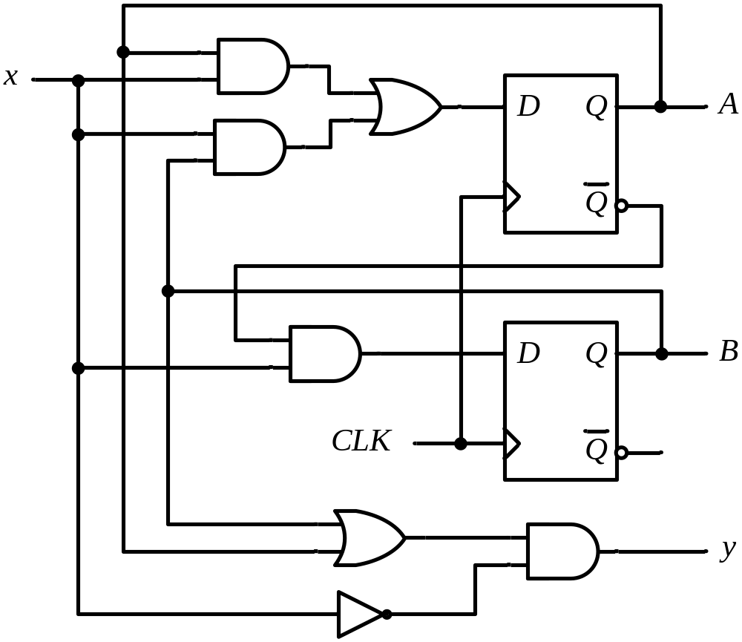
State Equations
Example
A(t+1) = D_{A}
= A(t) x(t)+B(t) x(t)
= A x + B x
B(t+1) = D_{B}
= A’(t) x(t)
= A’ x
y(t) = [A(t)+ B(t)] x’(t)
= (A + B) x’

Slide 11
State Table (Transition Table)
Example
Present State |  | Input | Next State |  | Output
A | B | x | A | B | y
0 | 0 | 0
0 | 0 | 1
0 | 1 | 0
0 | 1 | 1
1 | 0 | 0
1 | 0 | 1
1 | 1 | 0
1 | 1 | 1
0 0 0
0 1 0
0 0 1
1 1 0
0 0 1
1 0 0
0 0 1
1 0 0
A(t+1) = A x + B x
B(t+1) = A’ x
y(t) = (A + B) x’
t
t+1
t

Slide 12
State Table – Second Form
Example
Present State |  |  | Next State |  |  |  | Output
 |  |  | x = 0 |  | x = 1 |  | x = 0 | x = 1
A |  | B | A | B | A | B | y | y
0 |  | 0 | 0 | 0 | 0 | 1 | 0 | 0
0 |  | 1 | 0 | 0 | 1 | 1 | 1 | 0
1 |  | 0 | 0 | 0 | 1 | 0 | 1 | 0
1 |  | 1 | 0 | 0 | 1 | 0 | 1 | 0
t
t+1
t
A(t+1) = A x + B x
B(t+1) = A’ x
y(t) = (A + B) x’

Slide 13
State Diagram
Example
Present State |  |  | Next State |  |  |  | Output
 |  |  | x = 0 |  | x = 1 |  | x = 0 | x = 1
A |  | B | A | B | A | B | y | y
0 |  | 0 | 0 | 0 | 0 | 1 | 0 | 0
0 |  | 1 | 0 | 0 | 1 | 1 | 1 | 0
1 |  | 0 | 0 | 0 | 1 | 0 | 1 | 0
1 |  | 1 | 0 | 0 | 1 | 0 | 1 | 0
AB
input/output
0/0
1/0
0/1
0 0
1 0
0/1
1/0
0/1
1/0
0 1
1 1
1/0

Slide 14
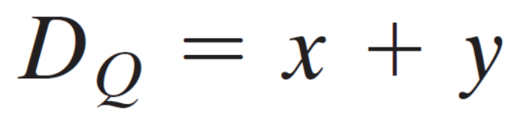
Summary
The state diagram gives a pictorial view of state transitions and is the form more suitable for human interpretation of the circuit’s operation .
Notation:
The I/p Eq. specifies an OR gate with inputs x and y connected to the D input of a flip-flop whose output is labeled with the symbol Q

Slide 15
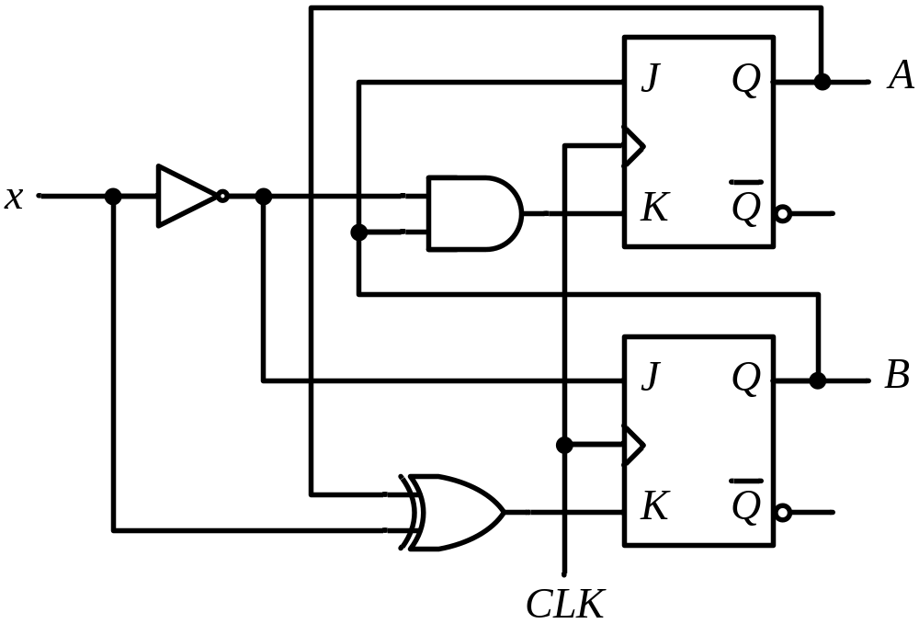
Analysis of Clocked Seq. Ccts (JK-F/F)

Slide 16
Analysis of Clocked Seq. Ccts (JK-F/F)
Present State |  | I/P | Next State |  | Flip-Flop Inputs
A | B | x | A | B | J_{A} | K_{A} | J_{B} | K_{B}
0 | 0 | 0
0 | 0 | 1
0 | 1 | 0
0 | 1 | 1
1 | 0 | 0
1 | 0 | 1
1 | 1 | 0
1 | 1 | 1
0 1
0 0
1 1
1 0
1 1
1 0
0 0
1 1
0 0 1 0
0 0 0 1
1 1 1 0
1 0 0 1
0 0 1 1
0 0 0 0
1 1 1 1
1 0 0 0
J_{A} = B K_{A} = B x’
J_{B} = x’ K_{B} = A ⊕ x
A(t+1) = J_{A} A’ + K’_{A} A
= A’B + AB’ + Ax
B(t+1) = J_{B} B’ + K’_{B} B
= B’x’ + ABx + A’Bx’

Slide 17
Analysis of Clocked Seq. Ccts (JK-F/F)
Present State |  | I/P | Next State
A | B | x | A | B
0 | 0 | 0
0 | 0 | 1
0 | 1 | 0
0 | 1 | 1
1 | 0 | 0
1 | 0 | 1
1 | 1 | 0
1 | 1 | 1
0 1
0 0
1 1
1 0
1 1
1 0
0 0
1 1
1
0
1
0 0
1 1
0
0
0
0 1
1 0
1
1

Slide 18
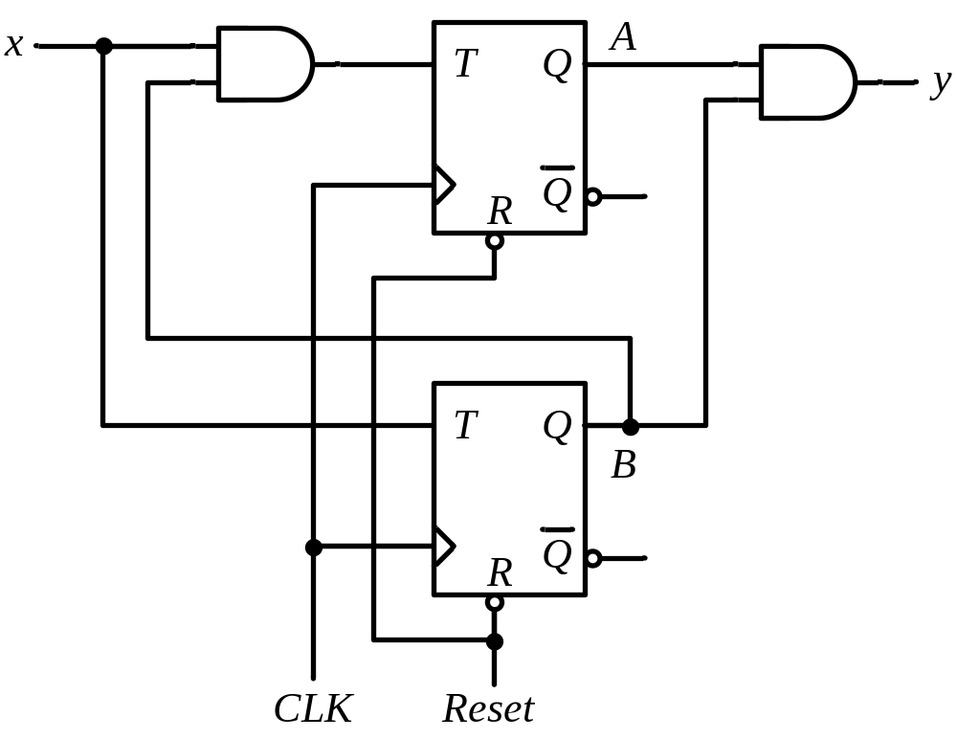
Analysis of Clocked Seq. Ccts (T-F/F)

Slide 19
Analysis of Clocked Seq. Ccts (T-F/F)
Present State |  | I/P | Next State |  | F.F Inputs |  | O/P
A | B | x | A | B | T_{A} | T_{B} | y
0 | 0 | 0
0 | 0 | 1
0 | 1 | 0
0 | 1 | 1
1 | 0 | 0
1 | 0 | 1
1 | 1 | 0
1 | 1 | 1
0 0
0 1
0 1
1 0
1 0
1 1
1 1
0 0
0 0
0 1
0 0
1 1
0 0
0 1
0 0
1 1
0
0
0
0
0
0
1
1
T_{A} = B x T_{B} = x
y = A B
A(t+1) = T_{A} A’ + T’_{A} A
= AB’ + Ax’ + A’Bx
B(t+1) = T_{B} B’ + T’_{B} B
= x ⊕ B

Slide 20
Analysis of Clocked Seq. Ccts (T-F/F)
Present State |  | I/P | Next State |  | F.F Inputs |  | O/P
A | B | x | A | B | T_{A} | T_{B} | y
0 | 0 | 0
0 | 0 | 1
0 | 1 | 0
0 | 1 | 1
1 | 0 | 0
1 | 0 | 1
1 | 1 | 0
1 | 1 | 1
0 0
0 1
0 1
1 0
1 0
1 1
1 1
0 0
0 0
0 1
0 0
1 1
0 0
0 1
0 0
1 1
0
0
0
0
0
0
1
1
0/0
0/0
0 0
1/0
0 1
1/1
1/0
1 1
1 0
0/1
0/0
1/0

